Slide 1
From hypothesis testing to Linear Regression: Basic concepts

Slide 2

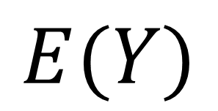
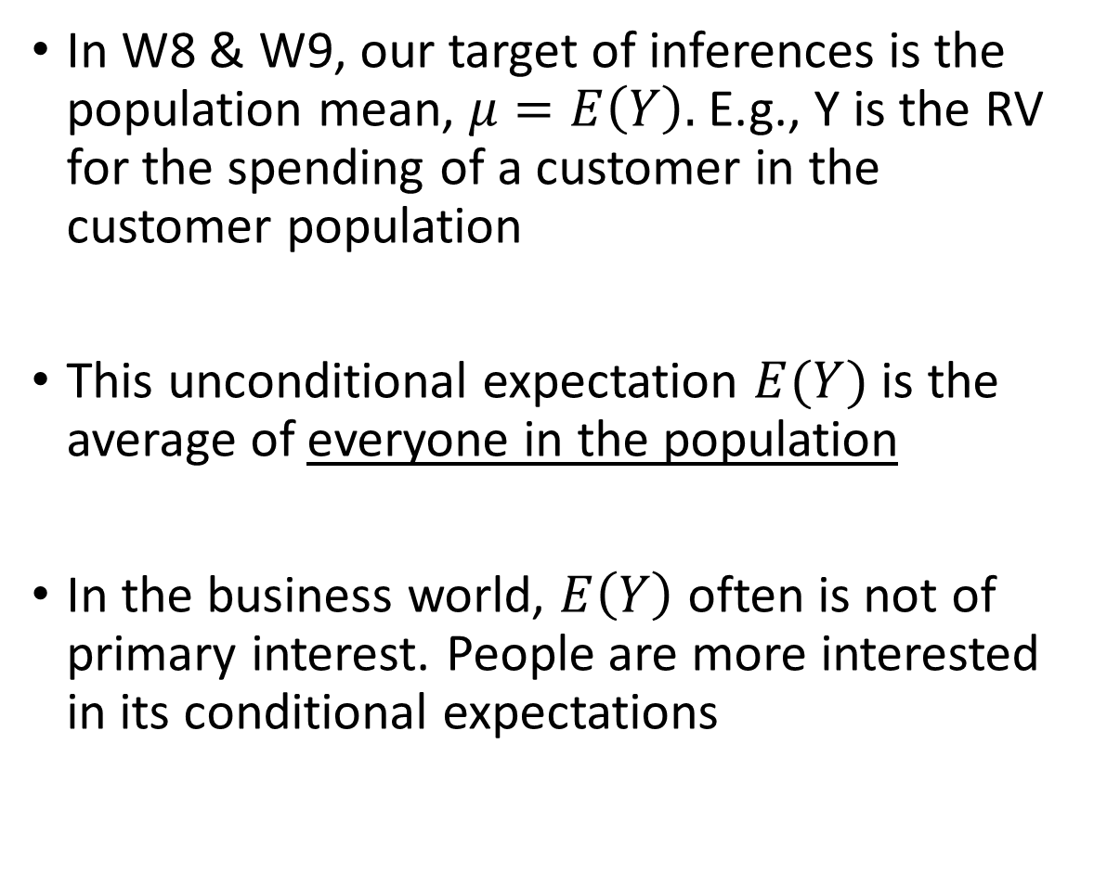
Population
In W8 & W9, our target of inferences is the population mean, $μ=E\left(Y\right).$ E.g., Y is the RV for the spending of a customer in the customer population
This unconditional expectation $E(Y)$ is the average of everyone in the population
In the business world, $E\left(Y\right)$ often is not of primary interest. People are more interested in its conditional expectations
$$E(Y)$$

Slide 3


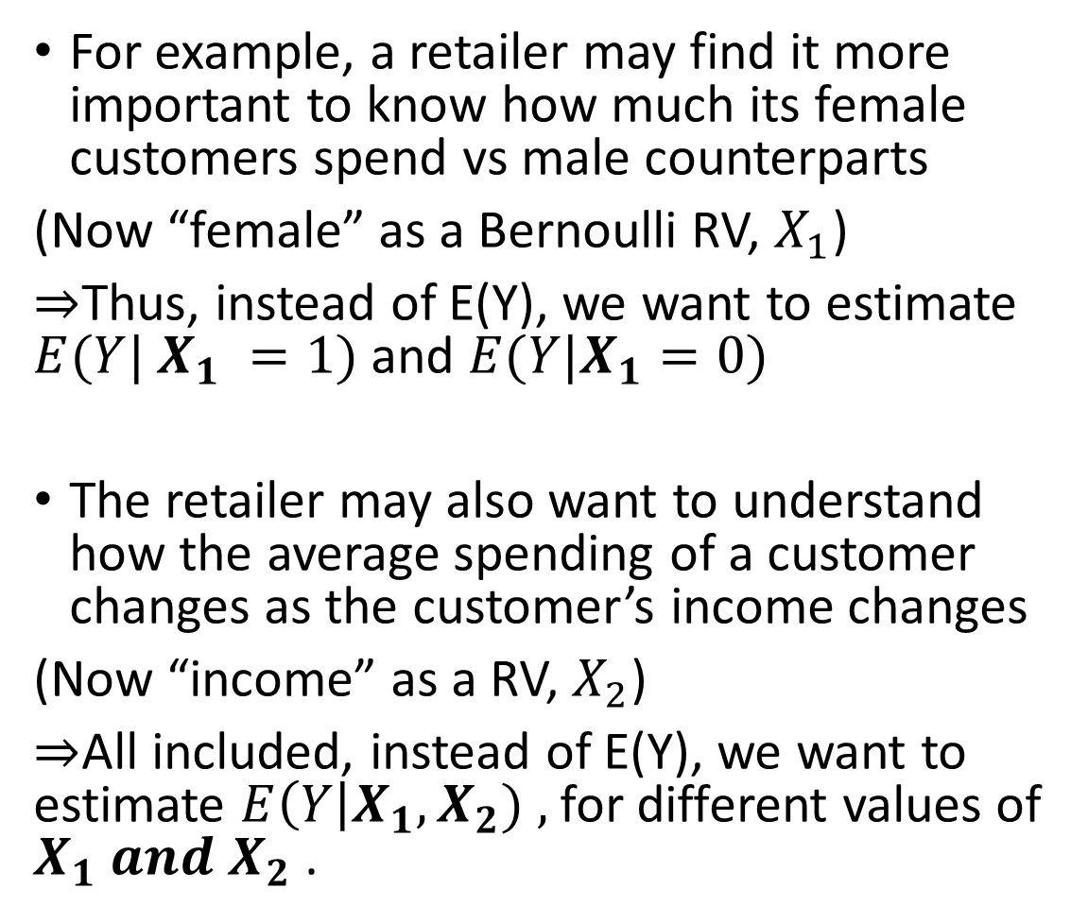
Population
For example, a retailer may find it more important to know how much its female customers spend vs male counterparts
(Now “female” as a Bernoulli RV, $X_{1}$)
$⇒$Thus, instead of E(Y), we want to estimate $E(Y| X_{1} =1)$and $E(Y|X_{1}=0)$
The retailer may also want to understand how the average spending of a customer changes as the customer’s income changes
(Now “income” as a RV, $X_{2}$)
$⇒$All included, instead of E(Y), we want to estimate $E\left(Y\right|X_{1},X_{2}) ,$for different values of $X_{1} and X_{2}$ .
$X_{1} =1$ (Female)
$X_{1}=0$ (Male)
$$E(Y)$$

Slide 4
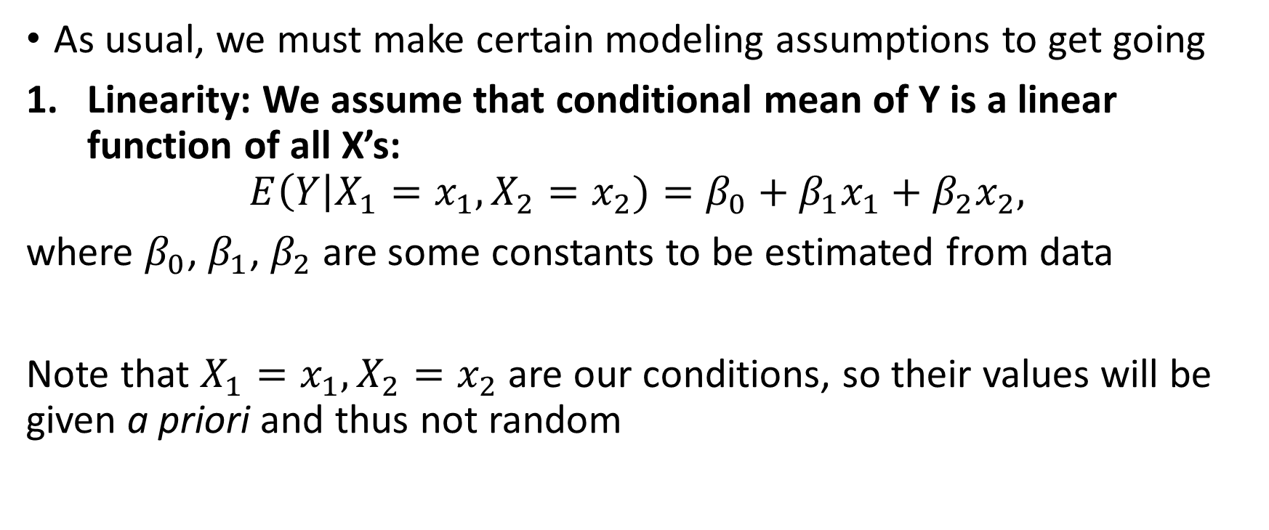
Model the conditional expectation
As usual, we must make certain modeling assumptions to get going
Linearity: We assume that conditional mean of Y is a linear function of all X’s:
$$E\left(Y\right|X_{1}=x_{1},X_{2}=x_{2})=β_{0}+β_{1}x_{1}+β_{2}x_{2},$$
where $β_{0}$, $β_{1}$, $β_{2}$are some constants to be estimated from data
Note that $X_{1}=x_{1},X_{2}=x_{2}$ are our conditions, so their values will be given a priori and thus not random

Slide 5
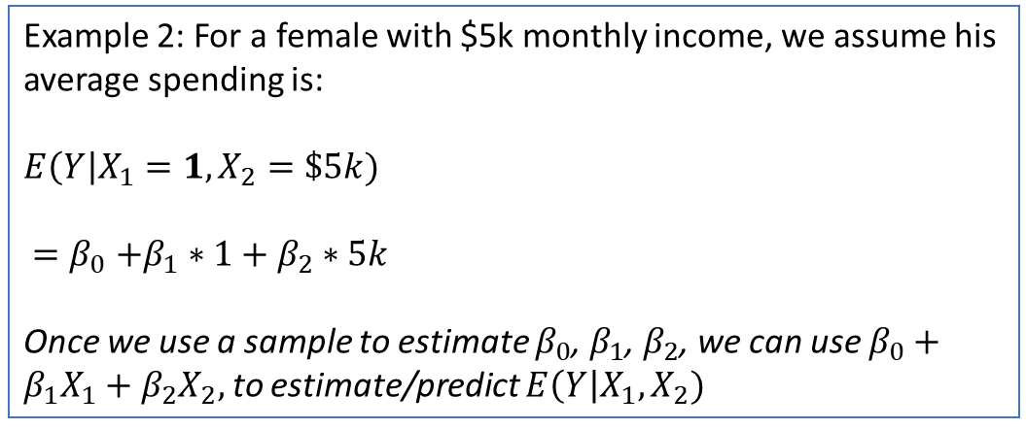
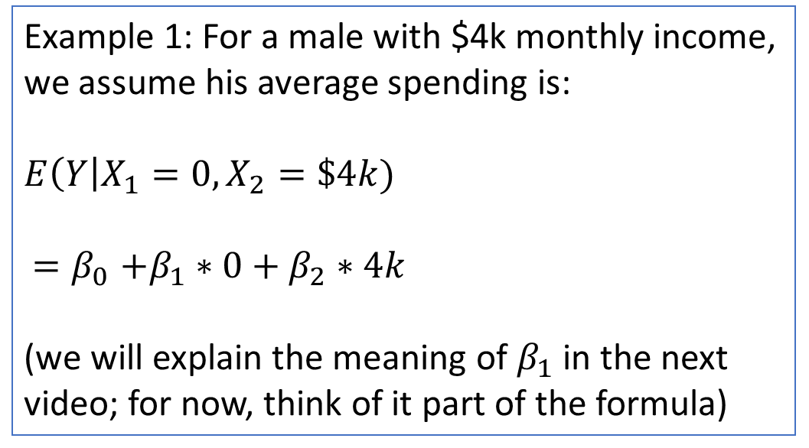
Example 1: For a male with $4k monthly income, we assume his average spending is:
$$E\left(Y\right|X_{1}=0,X_{2}=\$4k)$$
${=β}_{0}+β_{1}∗0+β_{2}∗4k$
(we will explain the meaning of $β_{1}$ in the next video; for now, think of it part of the formula)
$X_{1} =1$ (Female)
$X_{1}=0$ (Male)
Example 2: For a female with $5k monthly income, we assume his average spending is:
$$E\left(Y\right|X_{1}=1,X_{2}=\$5k)$$
${=β}_{0}+β_{1}∗1+β_{2}∗5k$
Once we use a sample to estimate $β_{0}$, $β_{1}$, $β_{2}$, we can use $β_{0}+β_{1}X_{1}+β_{2}X_{2},$ to estimate/predict $E\left(Y\right|X_{1},X_{2})$
$$E(Y)$$

Slide 6

Model the conditional expectation
2. Normality assumption: Assume that Y follows a normal distribution, given the X’s (to keep notation clean, I use $"|X_{1},X_{2}“$ to represent $"|X_{1}=x_{1} ,X_{2}=x_{2}“$)
This in effect means $\left(Y\right|X_{1},X_{2})\sim N\left(E\left(Y\right|X_{1},X_{2}),σ^{2}\right)$
$$⇒\left(Y\right|X_{1},X_{2})−E\left(Y\right|X_{1},X_{2})\sim N(0,σ^{2})$$
(EXAMPLE: spending of a random male customer with $4k income
minus the avg spending of all male customers with $4k income)
By Assumption 1, $E\left(Y\right|X_{1},X_{2})=β_{0}+β_{1}x_{1}+β_{2}x_{2}.$ Thus, $\left(Y\right|X_{1},X_{2})−(β_{0}+β_{1}x_{1}+β_{2}x_{2}$) is $N(0,σ^{2})$
Hoo…finally, we take the conditioning on $X’$s as implicitly given and simplify the expression, then we arrive at:
$Y=$ $β_{0}+β_{1}x_{1}+β_{2}x_{2}+ε$, where $ε\sim N(0,σ^{2})$
(the population model)

Slide 7
Summary
Simple but important!
Linear regression is built on estimating/predicting the conditional expectation of “Y”
Two assumptions: Linearity and Normality
(there are actually more underlying assumptions...but these two are the key ones for our purposes)

